Slide 1
Development of a Mobile Application to Screen Attention Impairments in Young Children and Facilitate Interventions.

Slide 2
Attention Types
Focused Attention
Focusing on a single visual stimuli
Divided Attention
Focusing a part of their attention on multiple items at the same time.
Selective Attention
Focusing on a specific stimuli while filtering out distactions.
Alternating Attention
Sustained Attention
Shifting attention between two stimuli.
Focusing on a task for a continuous stretch of time.

Slide 3
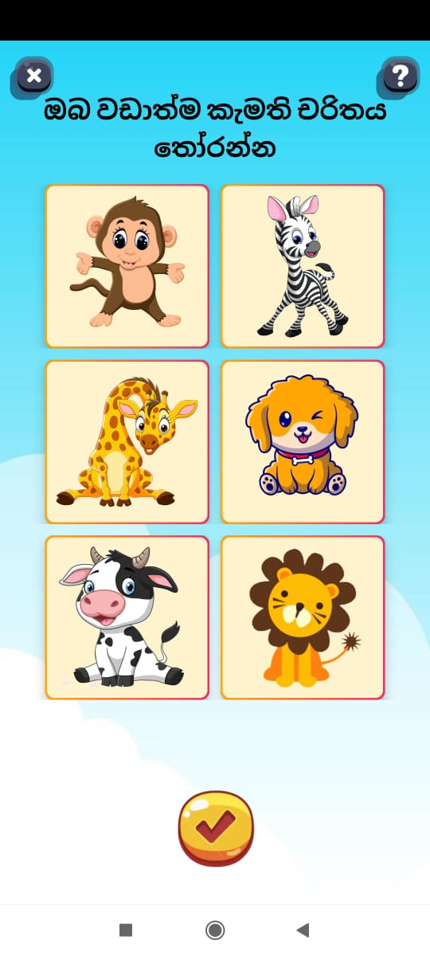
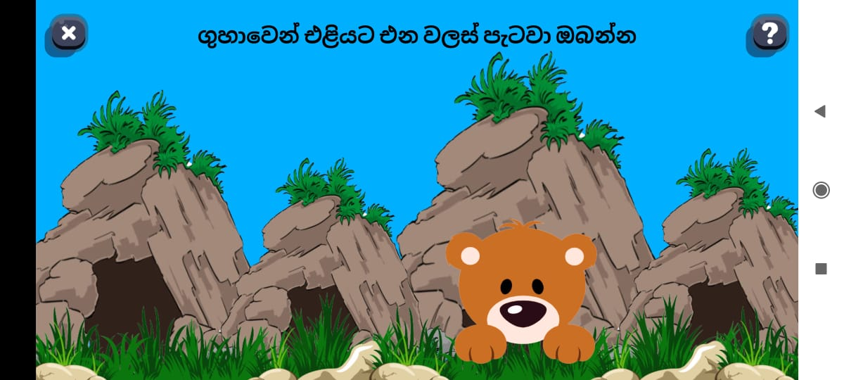

Focused Attention Assessment

Slide 4
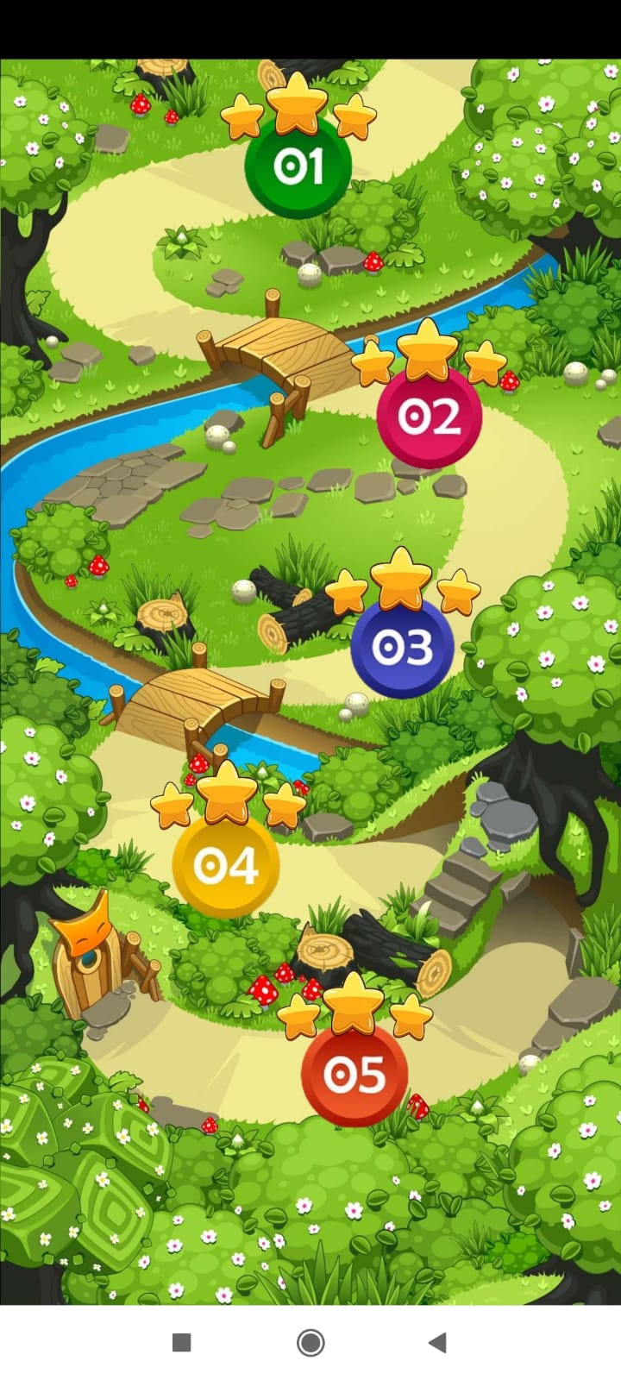
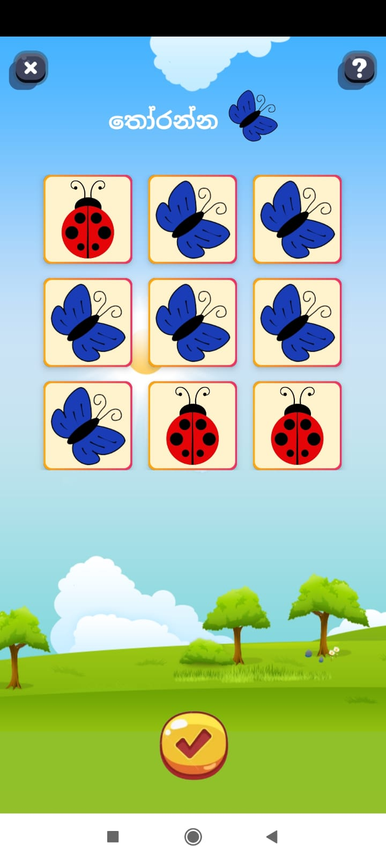
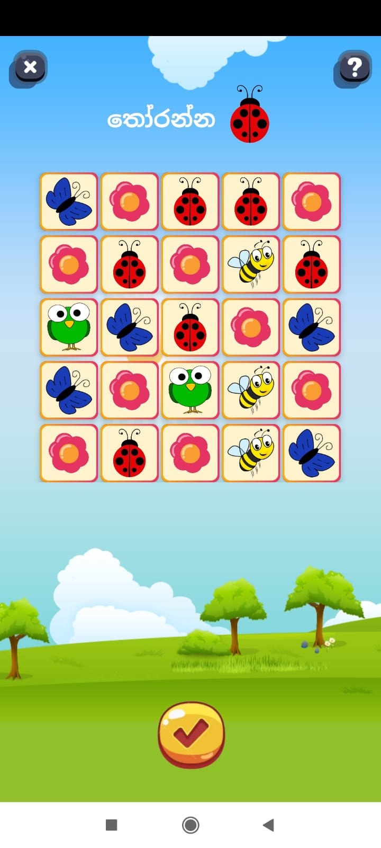
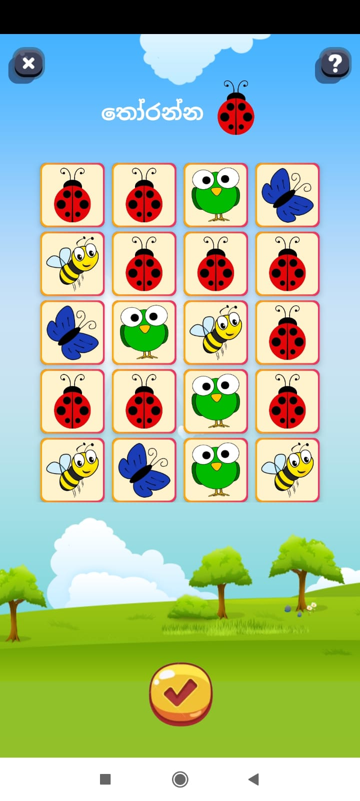
Selective Attention Assessment

Slide 5


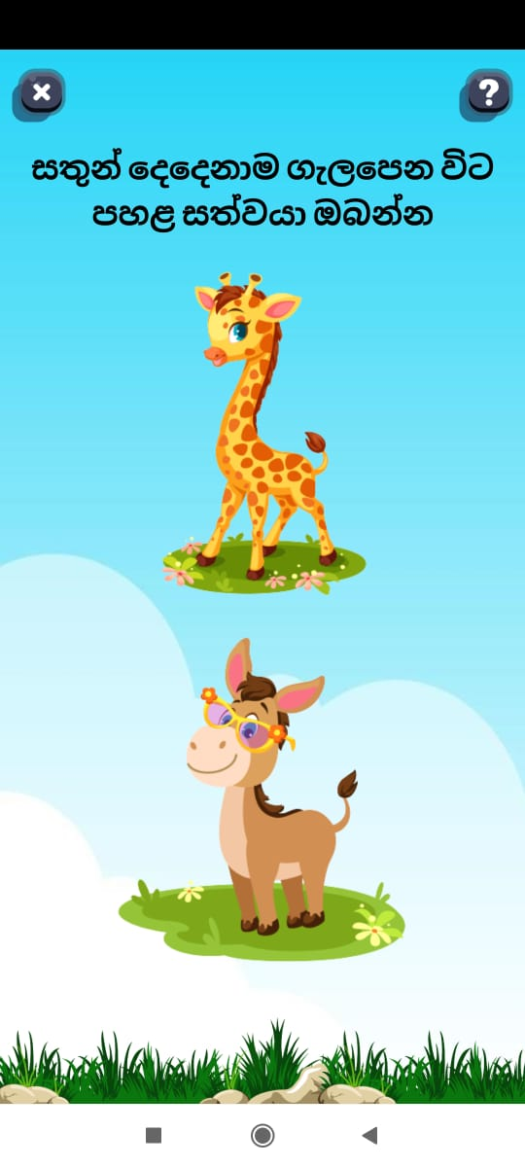
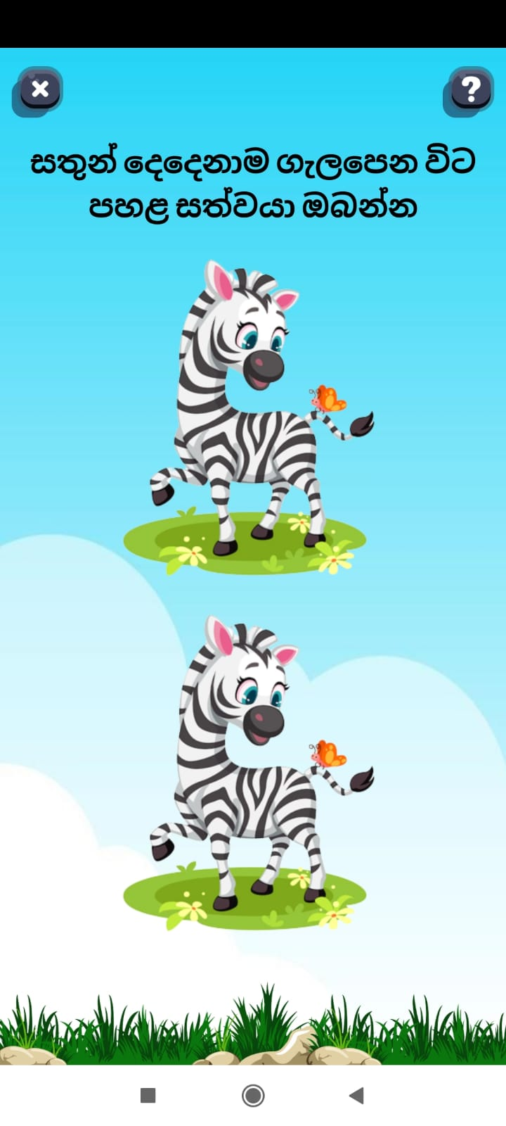
Divided Attention Assessment

Slide 6
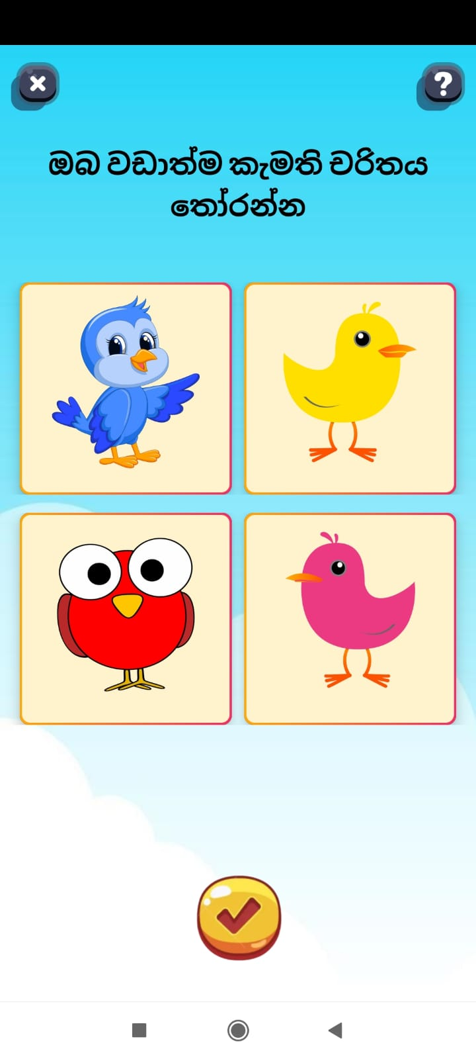
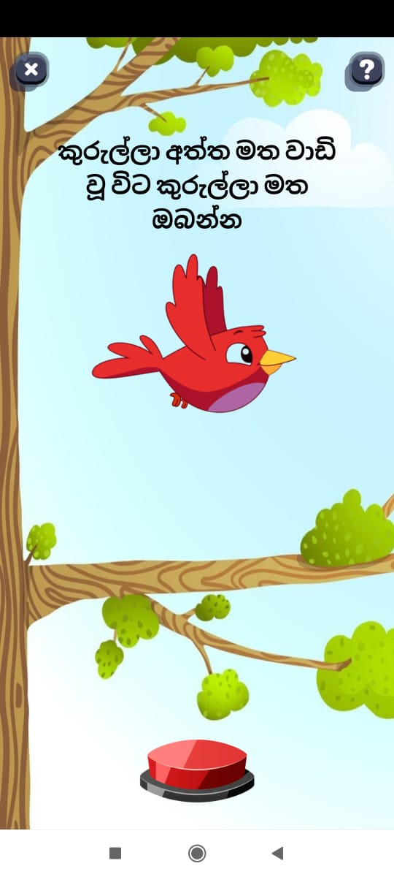
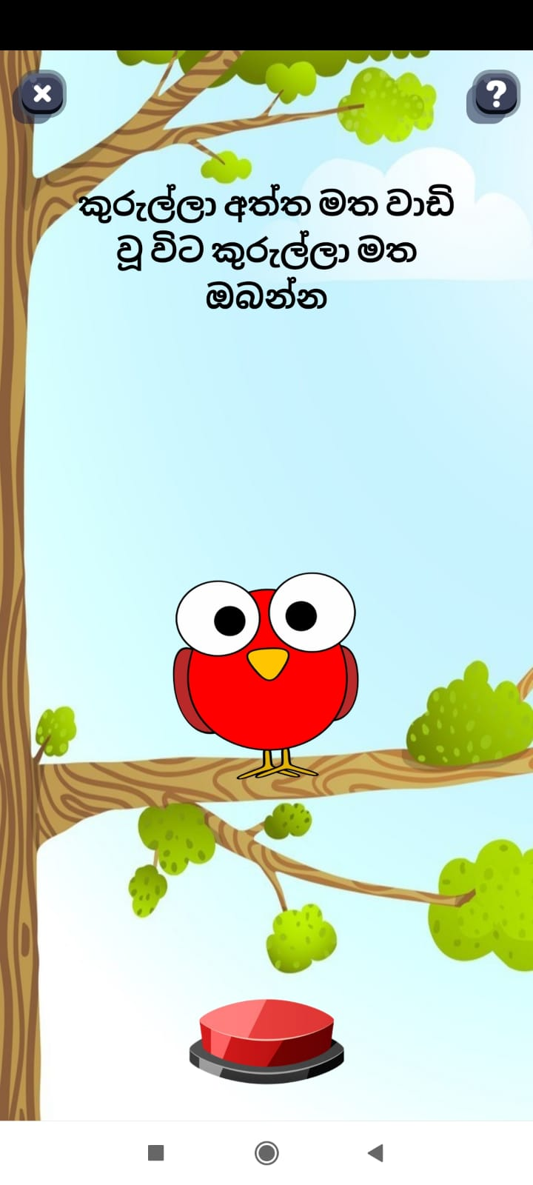
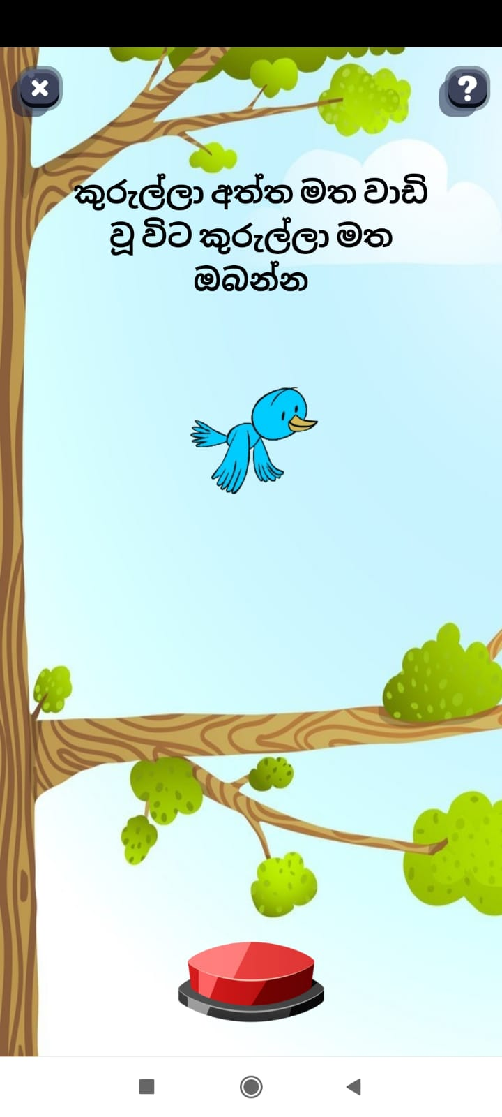
Sustained Attention Assessment

Slide 7
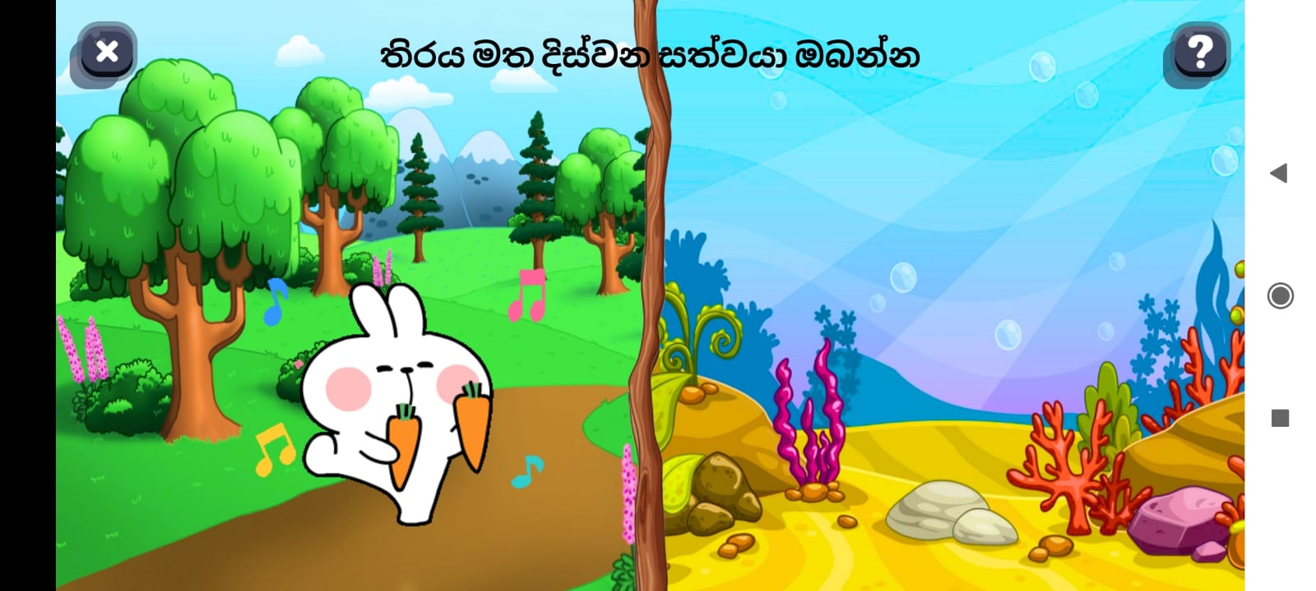
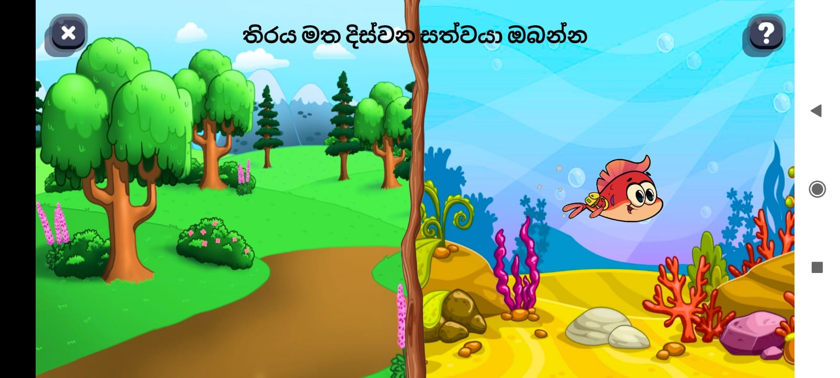
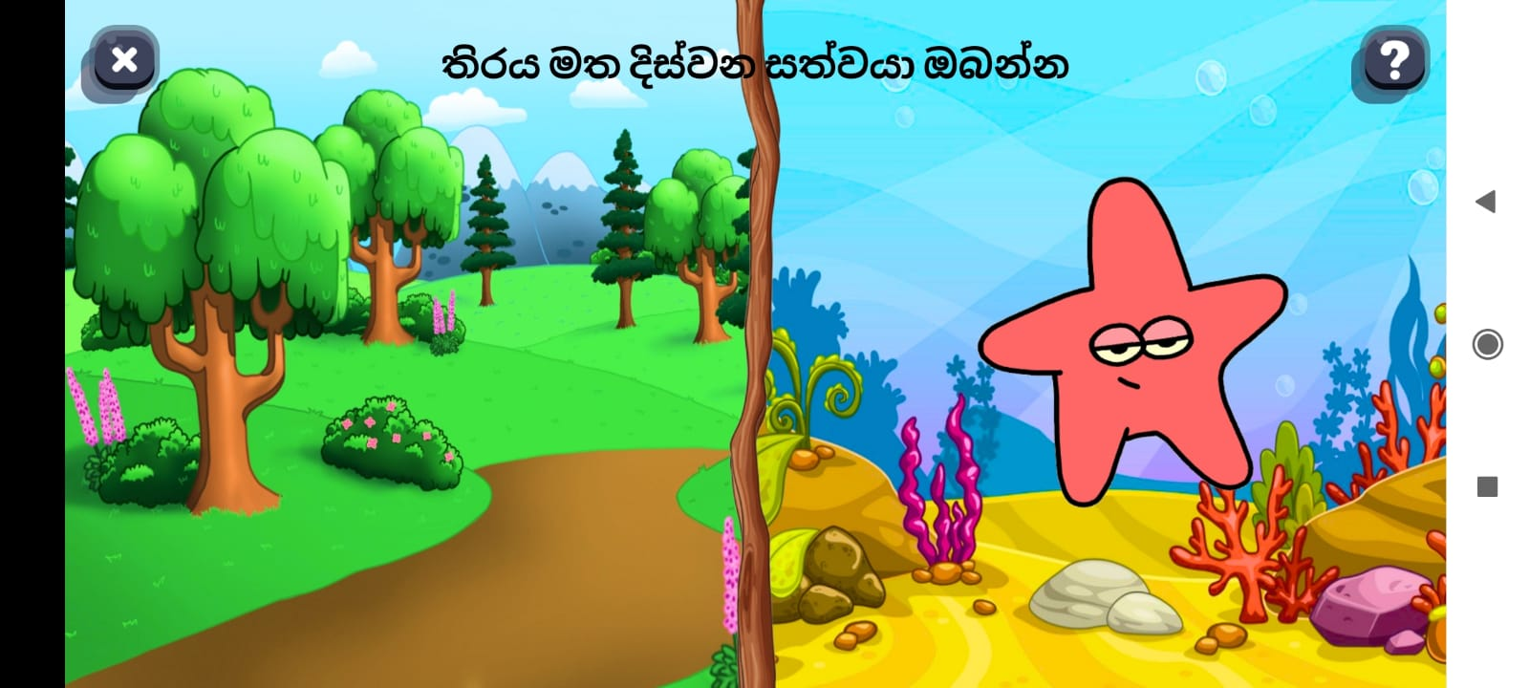
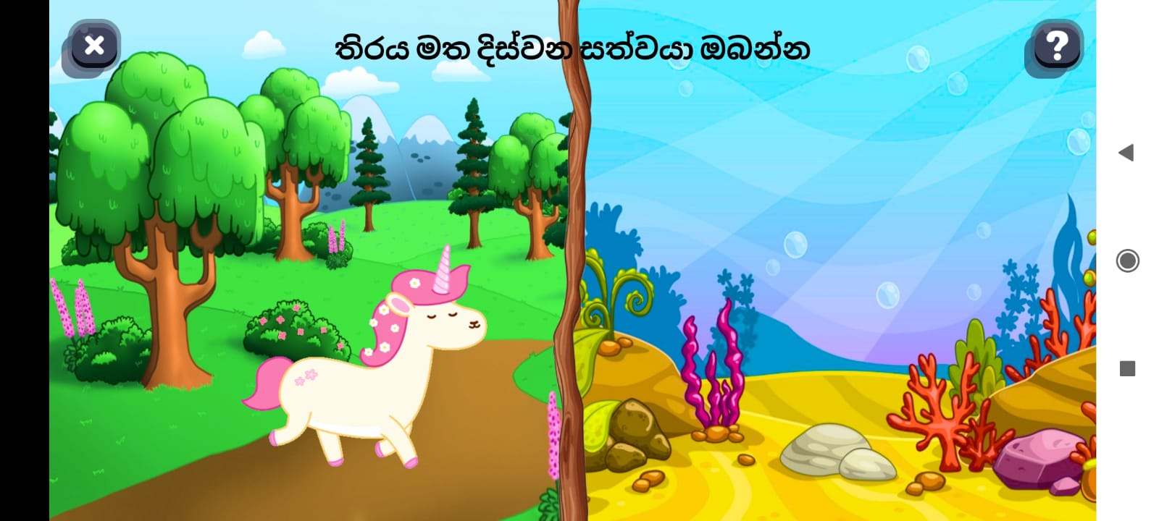
Alternating / Shifting Attention Assessment

Slide 8
Thank You!

Slide 9
Data count
Game | 4 years old |  |  | 5 years old
 | Total | Male | Female | Total | Male | Female
Alternating Attention | 11
Divided Attention | 11
Sustained Attention | 8
Focused Attention | 26
Selective Attention | 55

